Slide 1
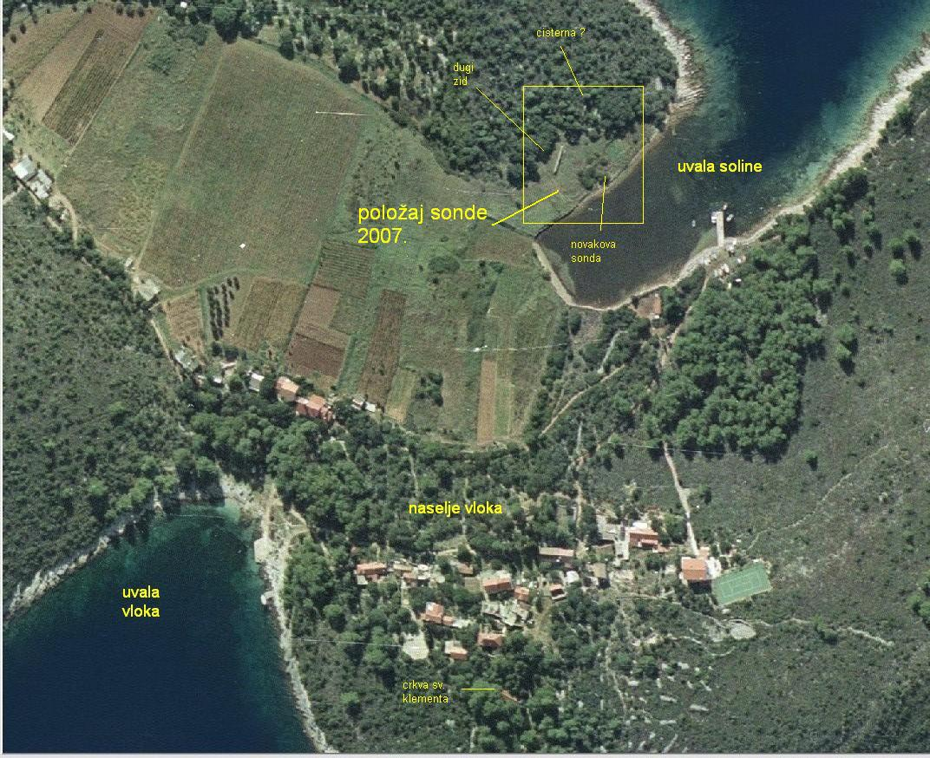

Slide 2
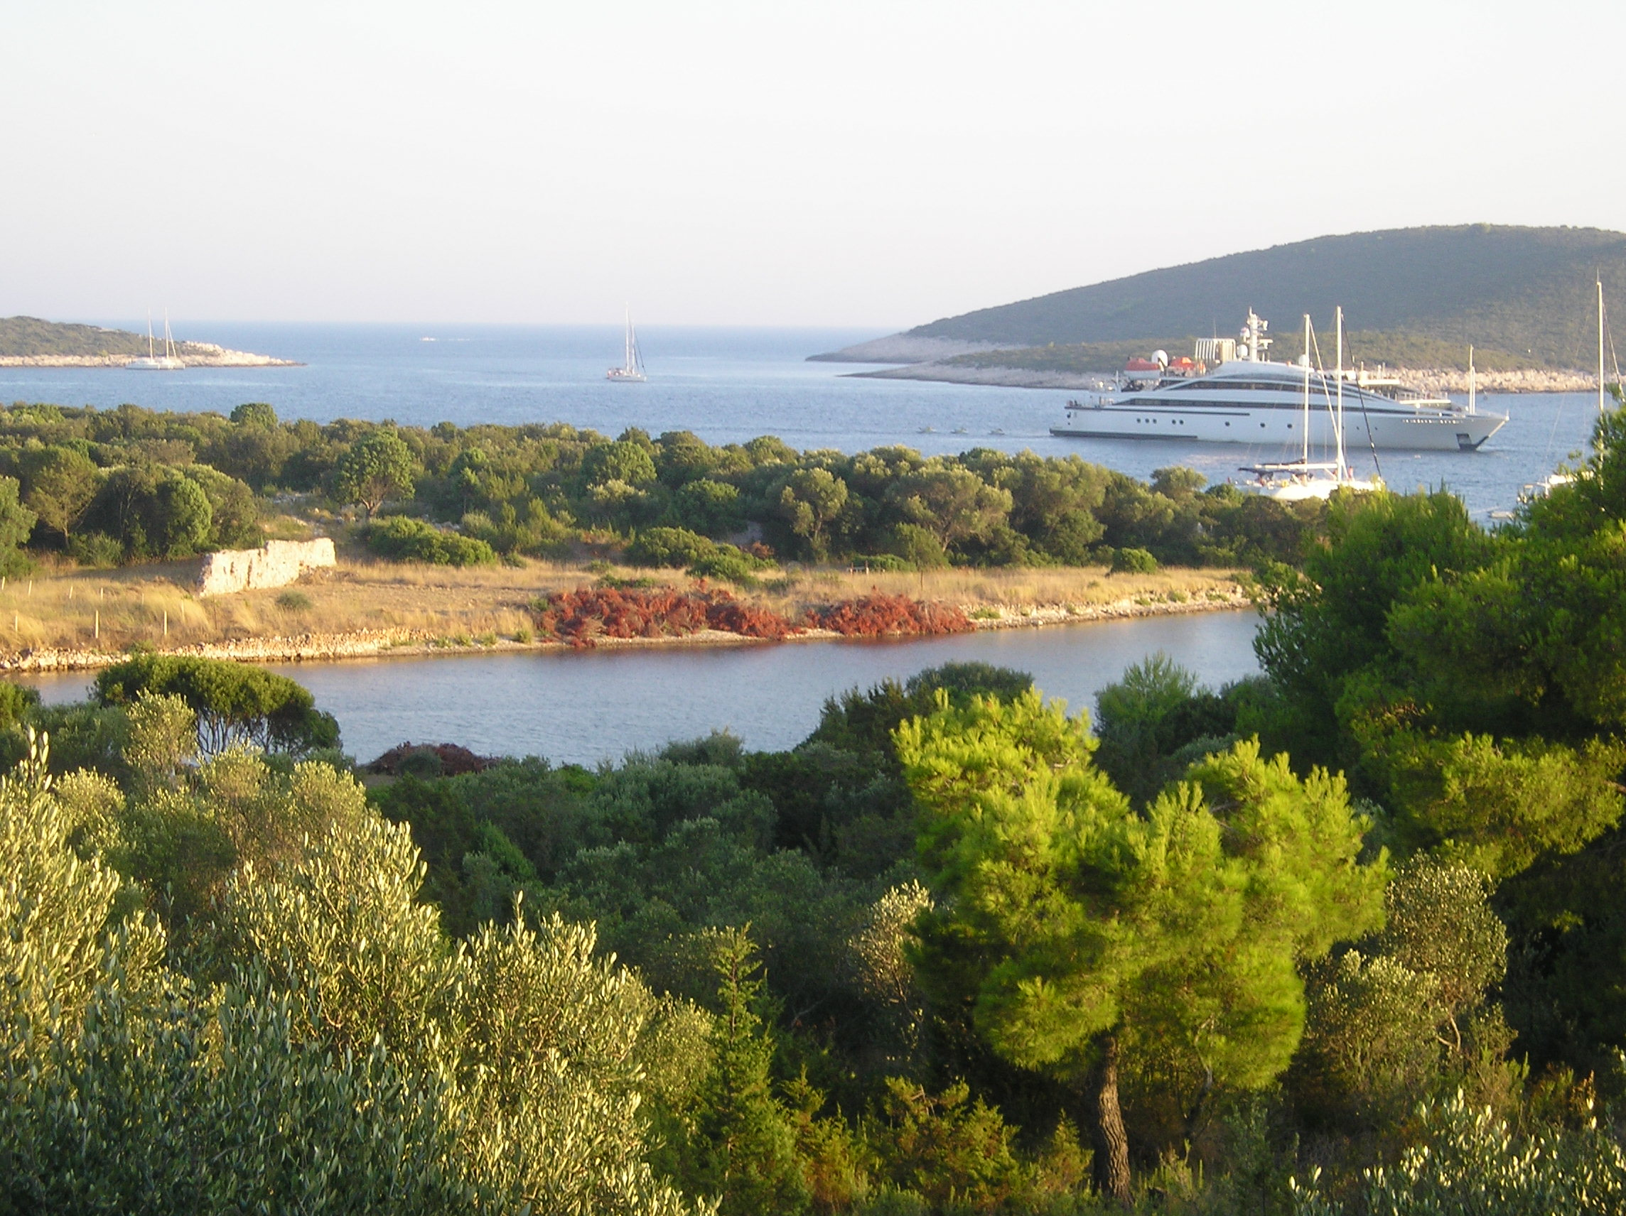
SITE VIEW 2007

Slide 3
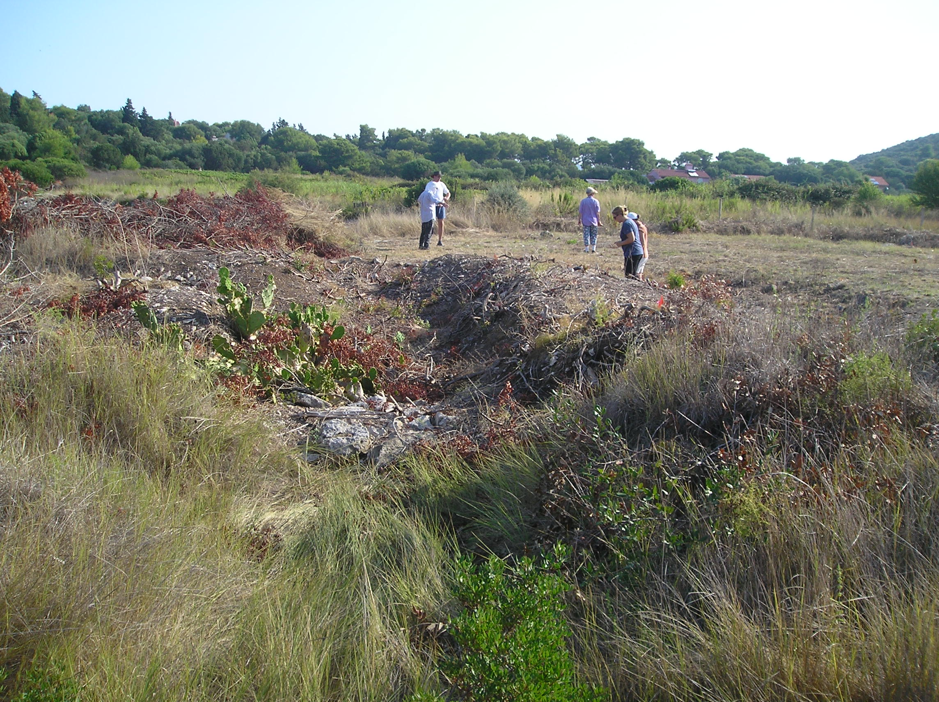
FIRST DAY, CLEARING THE SITE FOR MAGNETOMETRIC SURVEY, 2007

Slide 4
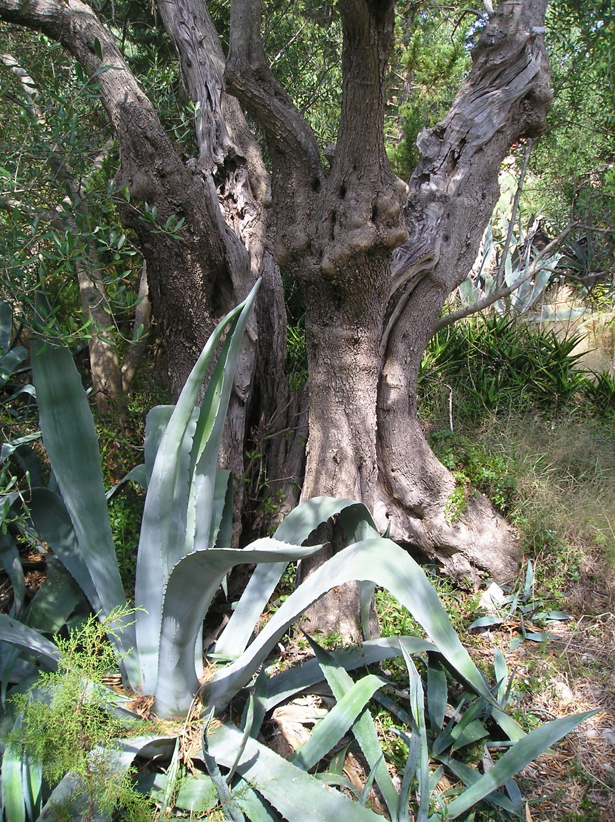
SV. KLEMENT, ANCIENT OLIVE TREE NEAR THE SITE, 2007

Slide 5
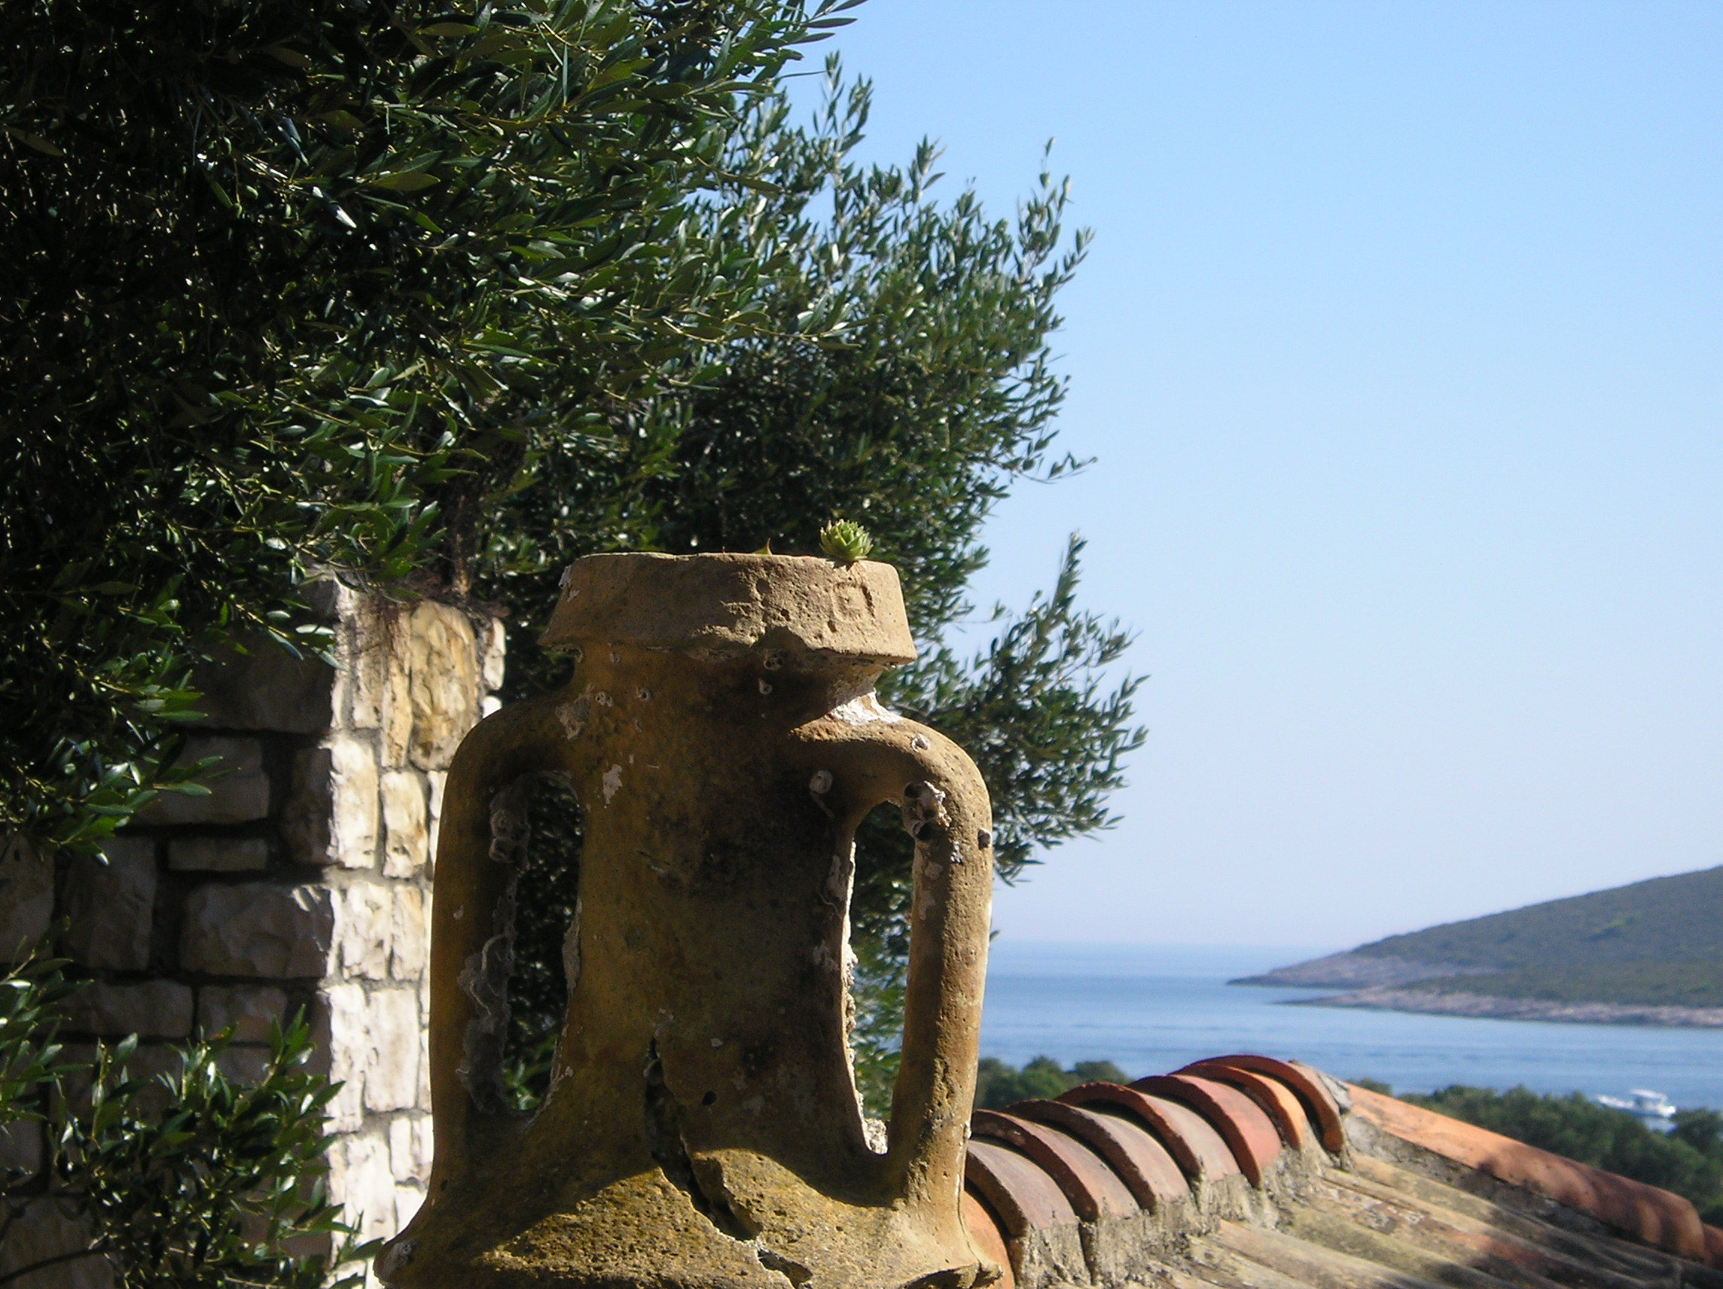
ROMAN AMPHORA AT THE EXCAVATION HOUSE, 2007

Slide 6
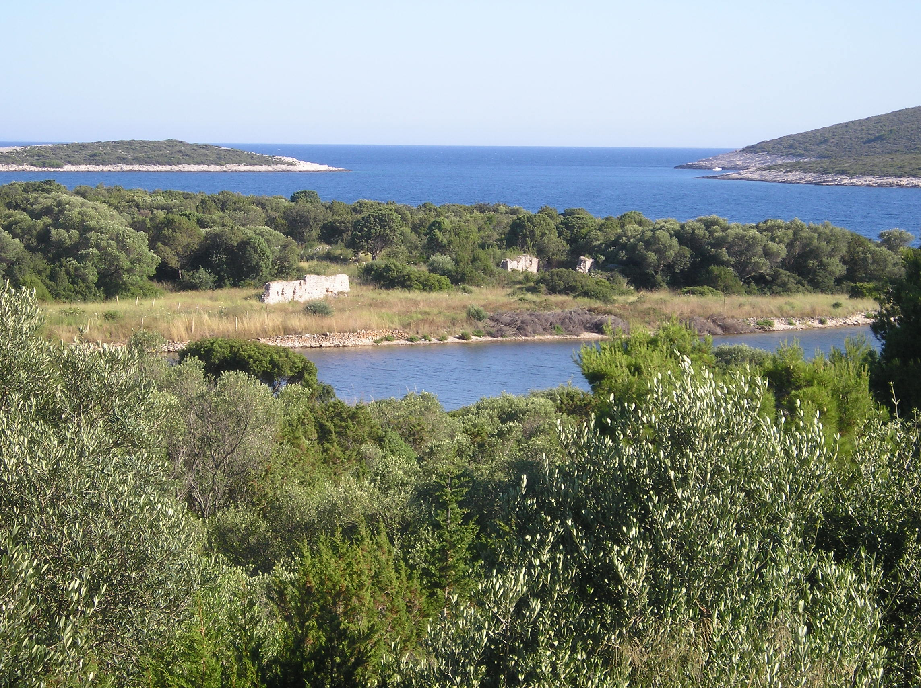
SITE VIEW 2008

Slide 7
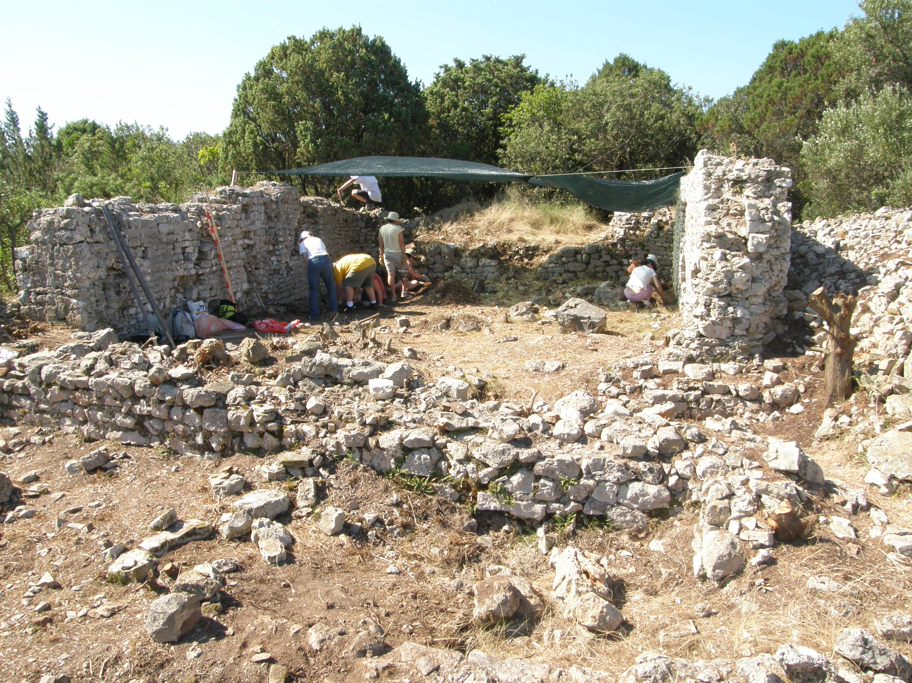
EXCAVATION, BUILDING A, 2008

Slide 8
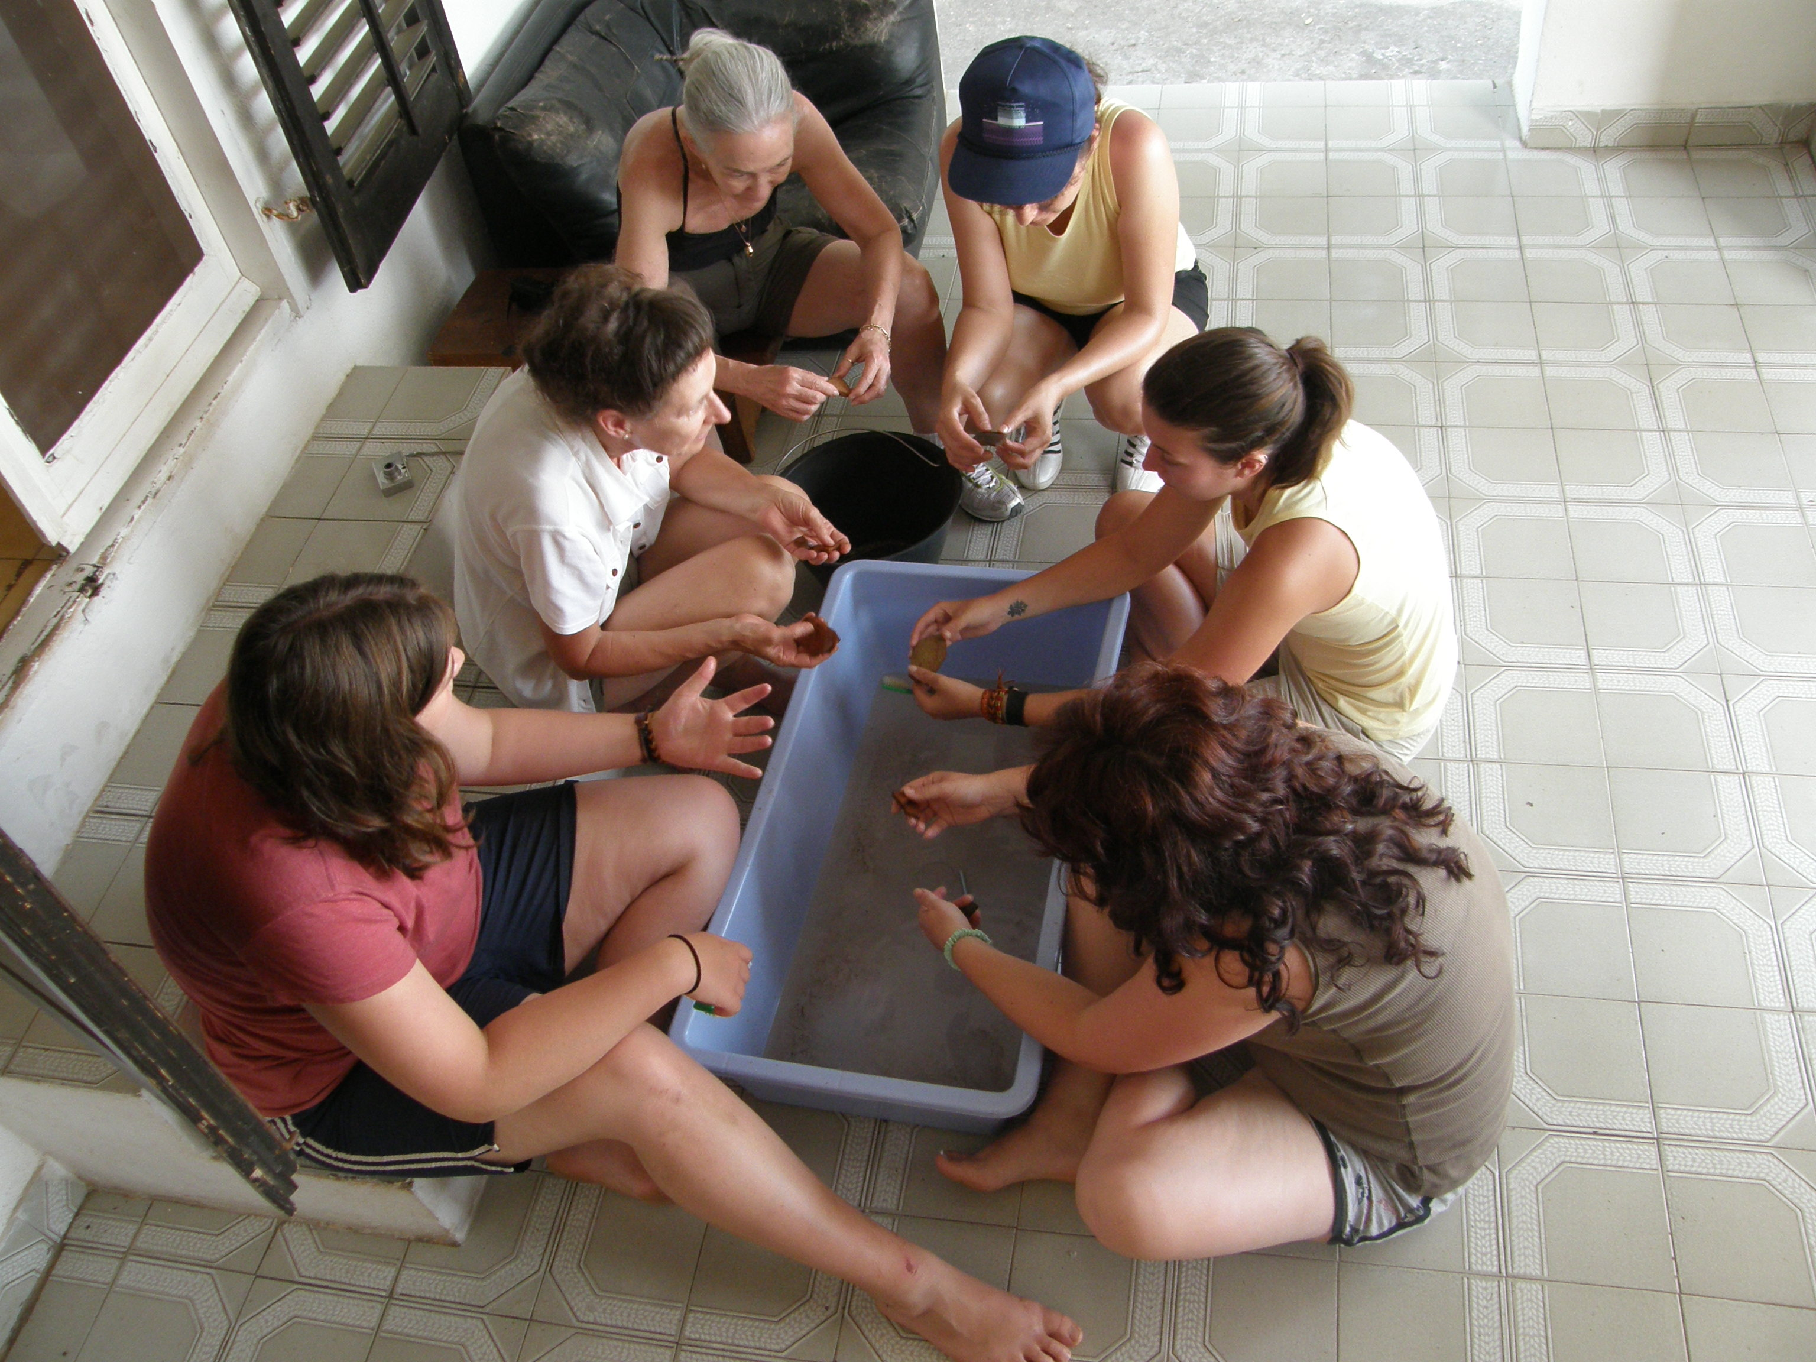
POTTERY WASH, STUDENTS and VOLUNTEERS, 2008

